Slide 1
Implementation of probability diffusion algorithm with Python
School of Electrical Engineering, University of Belgrade
Nikola Miličević 3130/2021
Danilo Lalić 3260/2021

Slide 2
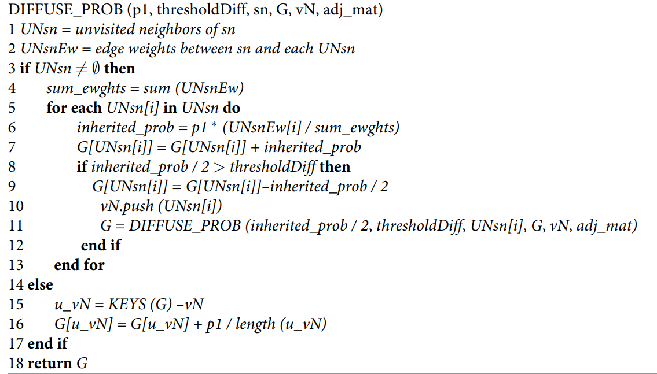
Pseudocode of probability diffusion algorithm

Slide 3
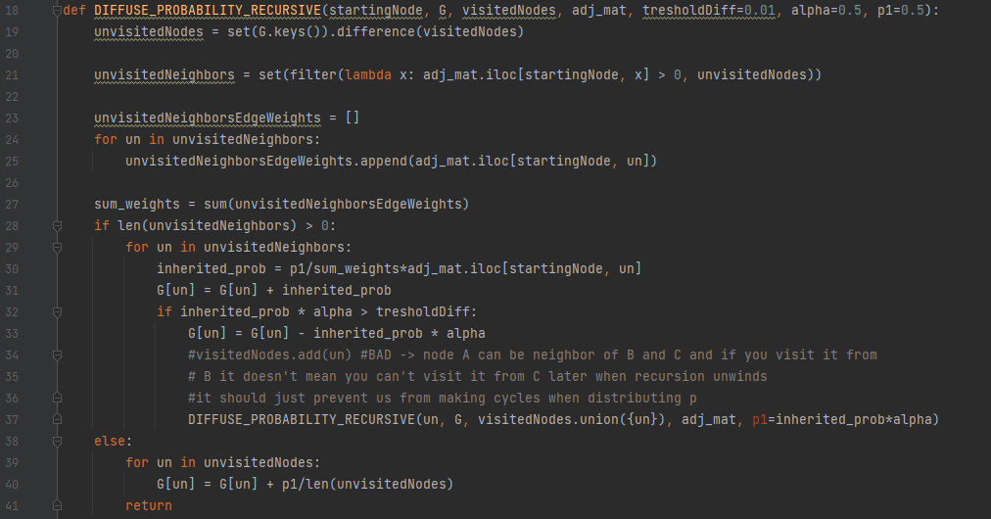
Recursive implementation

Slide 4
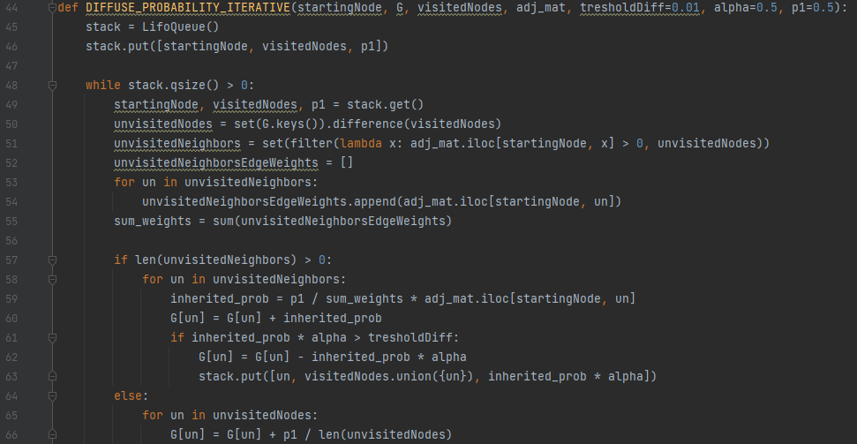
Iterative implementation

Slide 5
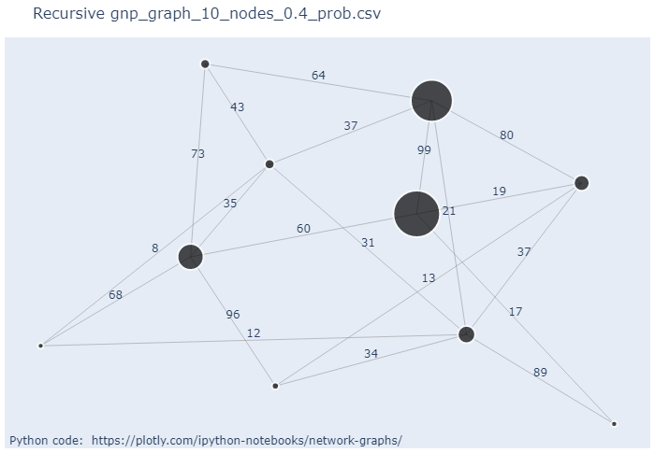
Graph generation
For generating different graphs, we used functions from NetworkX library; prototypes of those functions are listed below:
gnp_random_graph(n, p, seed=None, directed=False); list of probabilities: p = [0.25, 0.4]
random_geometric_graph(n, radius, dim=2, pos=None, p=2, seed=None); list of radiuses: p = [0.5, 0.8]
random_regular_graph(d, n, seed=None); list of degrees: d = [2, 5]
Graphs with sizes of 10, 60, 500, 1500 nodes were generated.

Slide 6
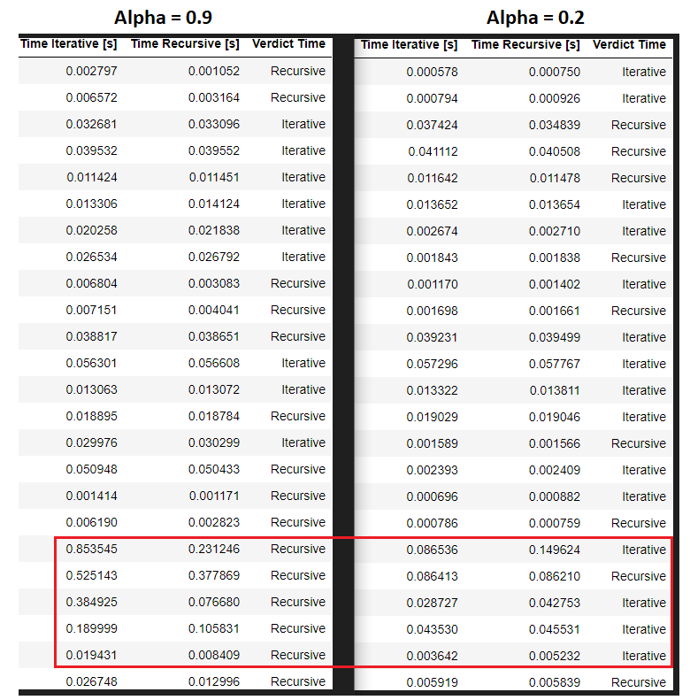
Alpha parameter

Slide 7
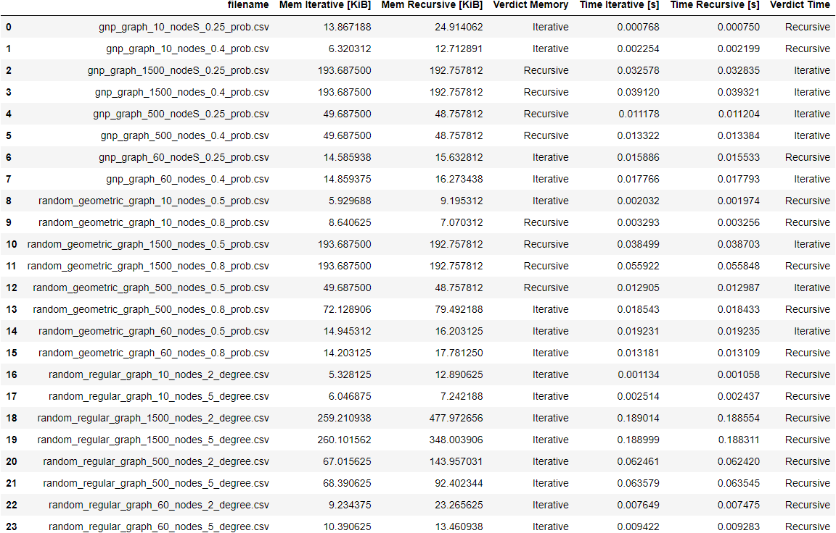
Results

Slide 8
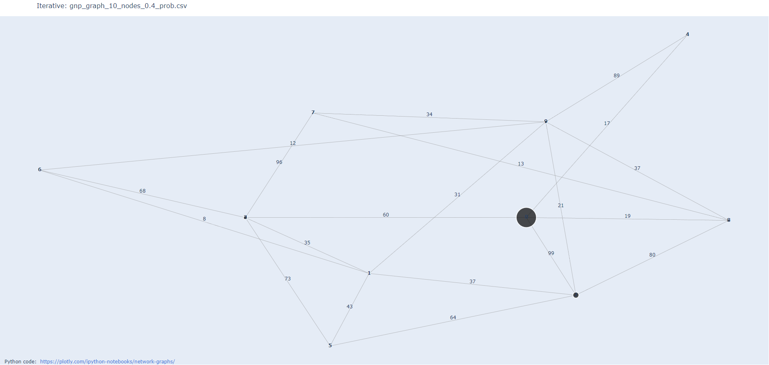
Visualization

